Slide 1

Reinforcement Learning-based Frequency Control for Renewable Energy Microgrids

Slide 2
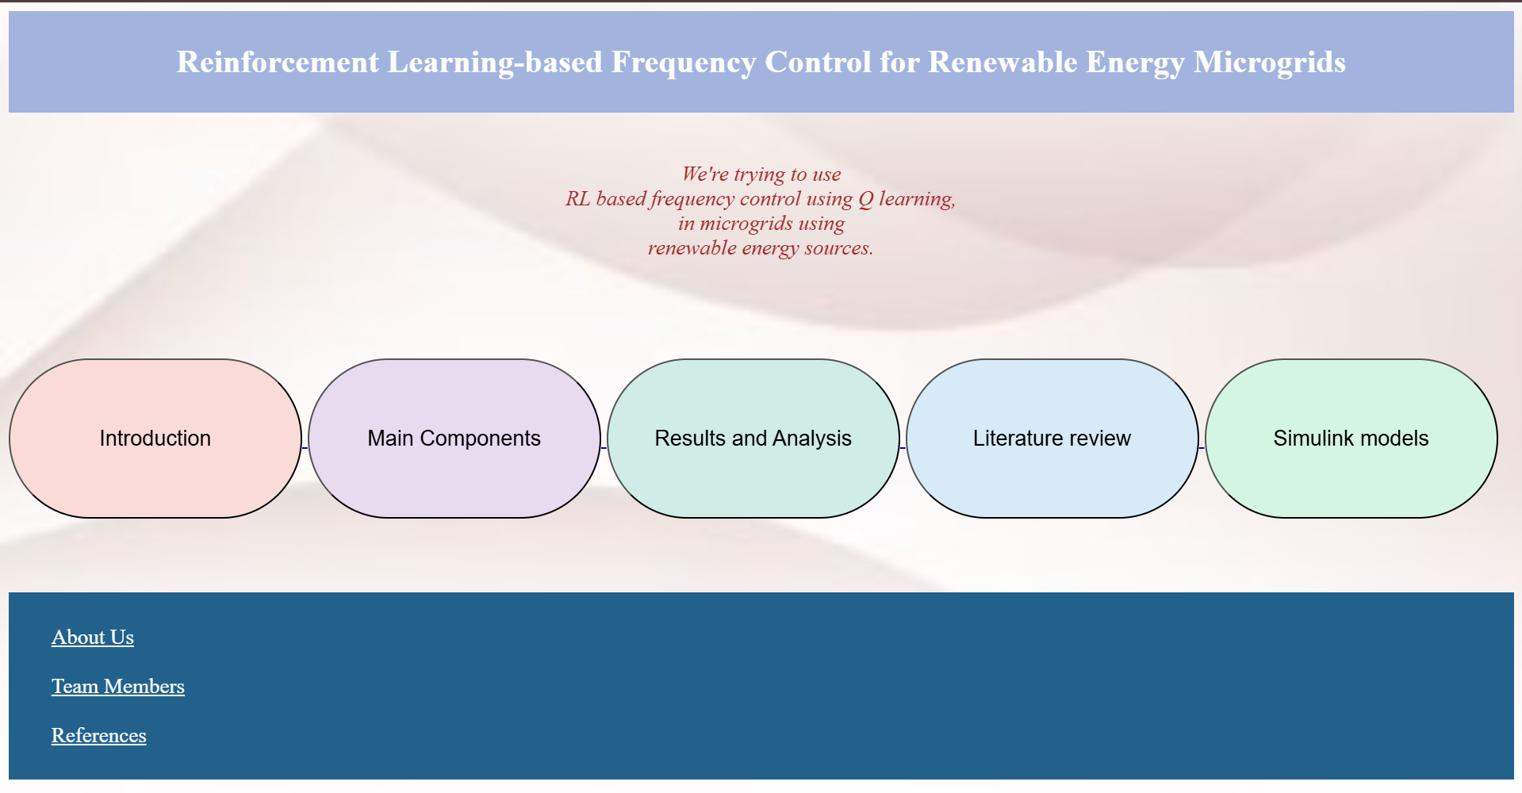
INTRODUCTION PAGE

Slide 3
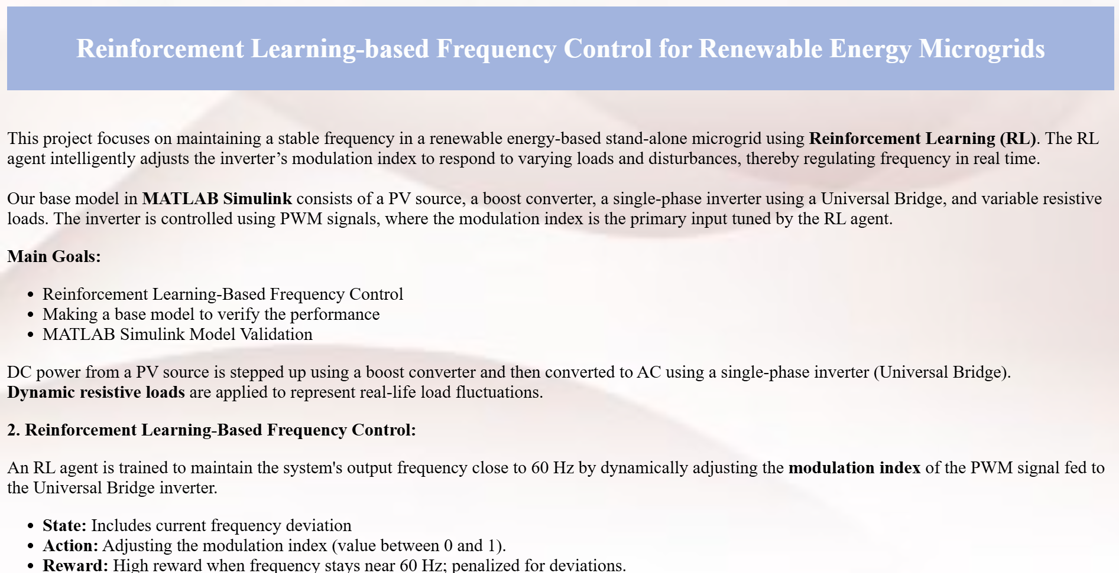
OUR AIM PAGE

Slide 4
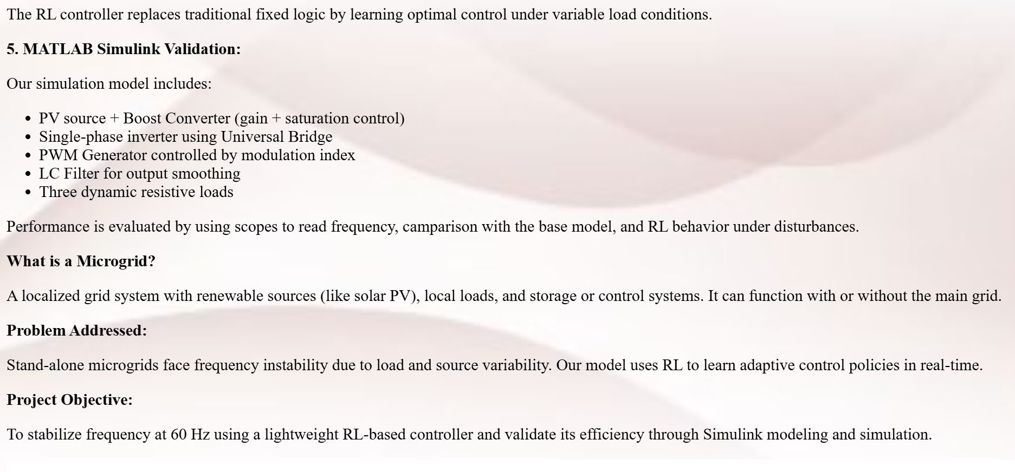
OUR AIM PAGE

Slide 5
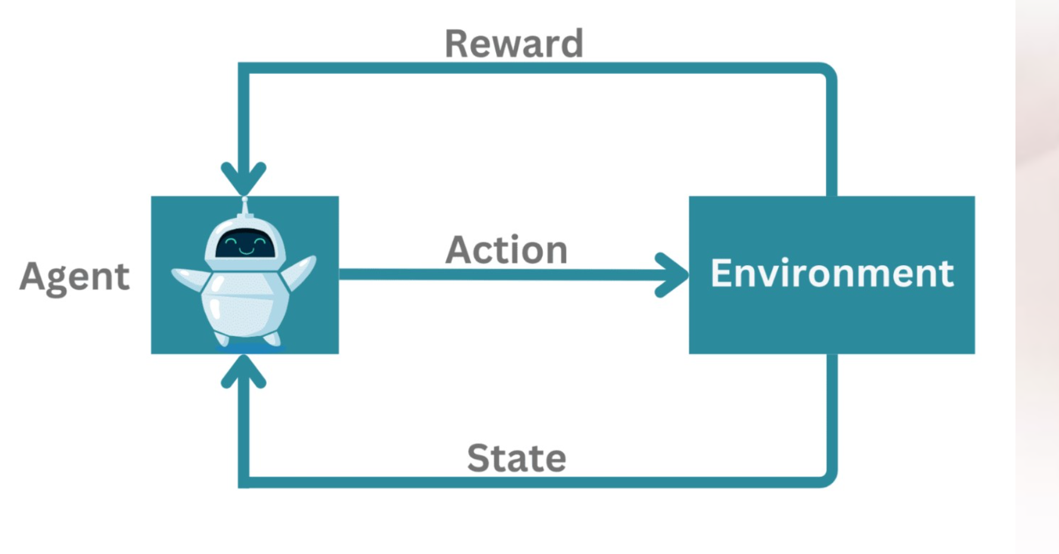
OUR AIM PAGE

Slide 6
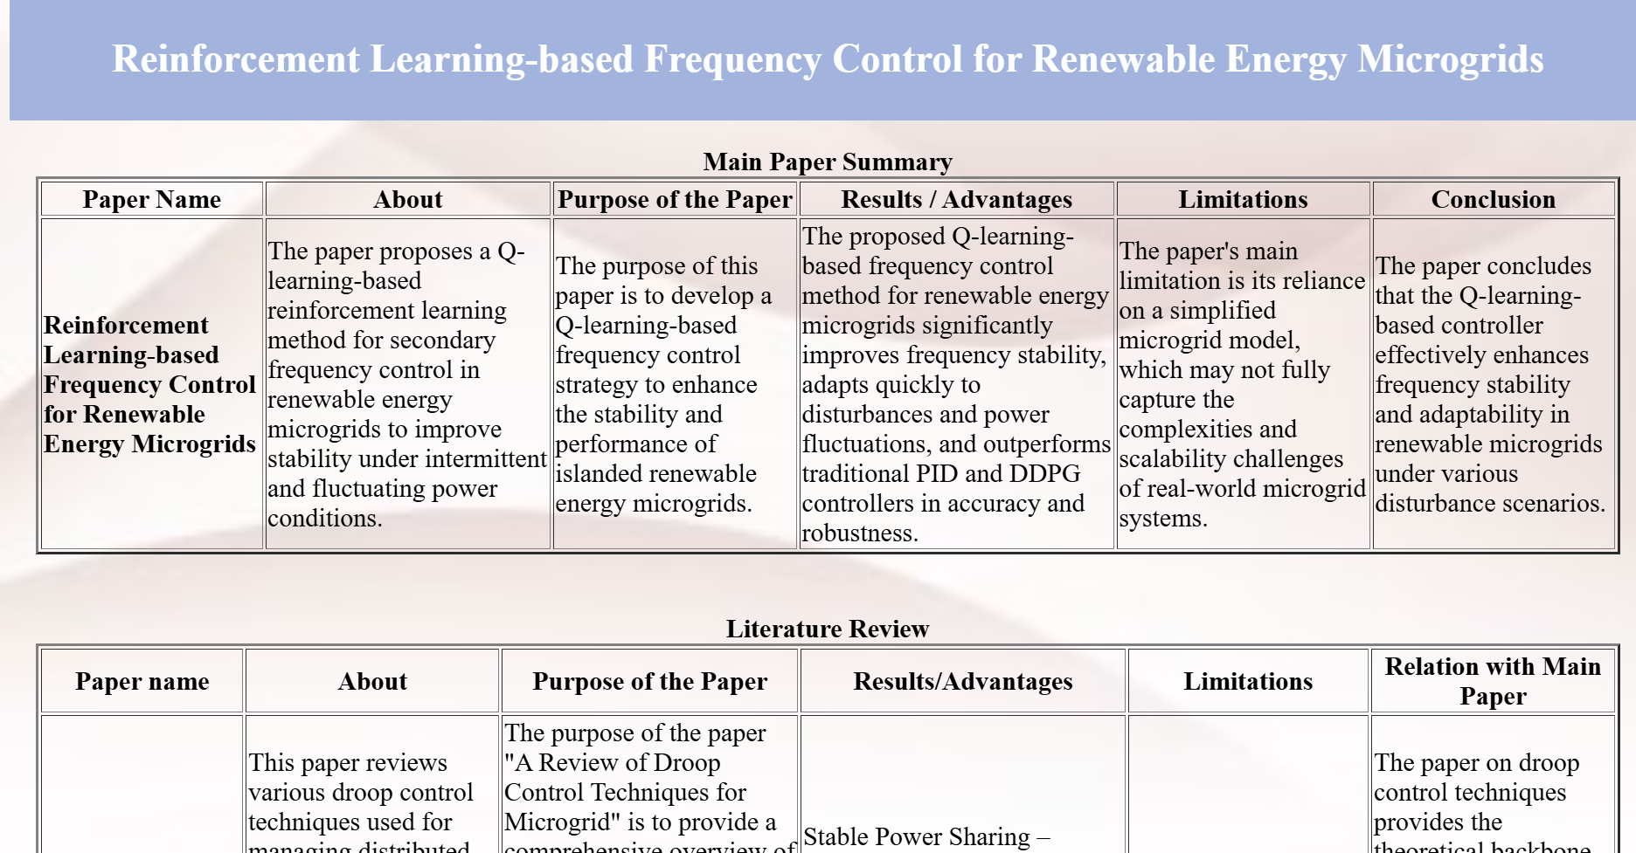
LITERATURE REVIEW

Slide 7
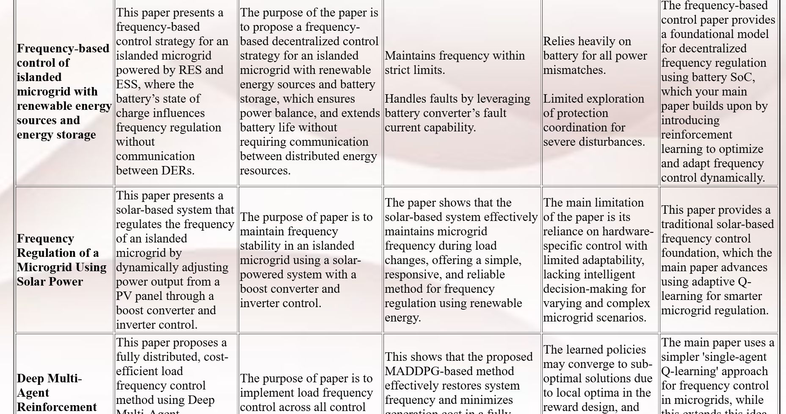
LITERATURE REVIEW

Slide 8
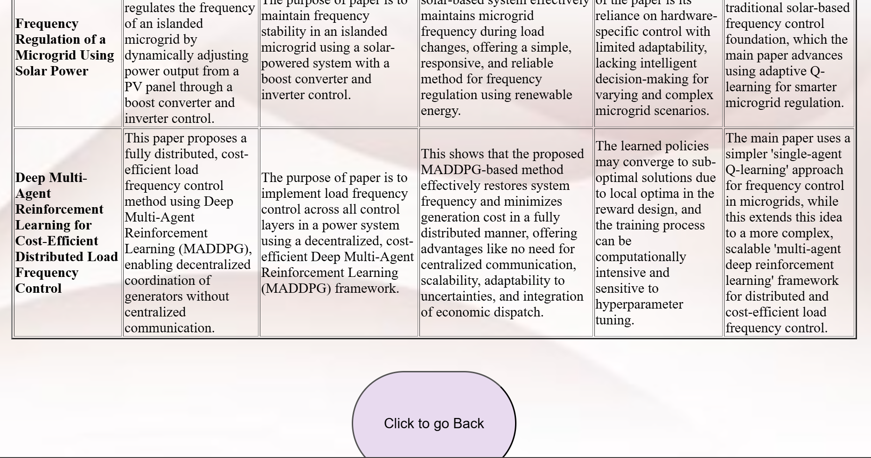
LITERATURE REVIEW

Slide 9
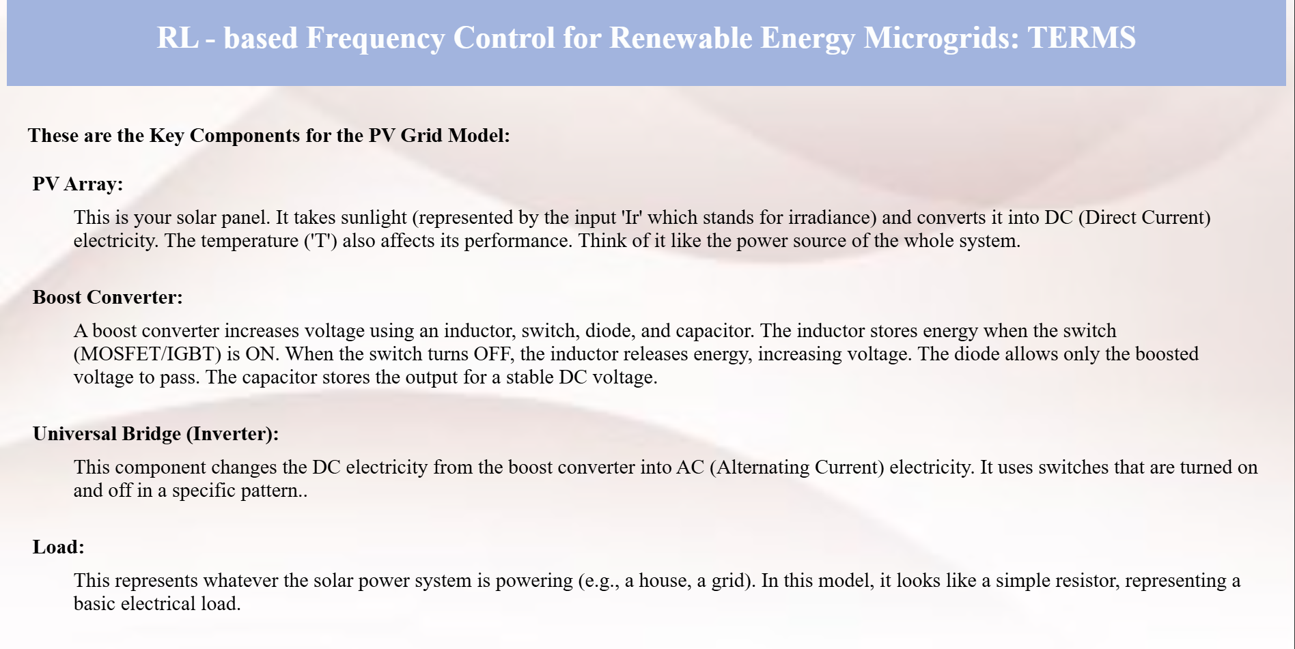
MAIN COMPONENTS

Slide 10
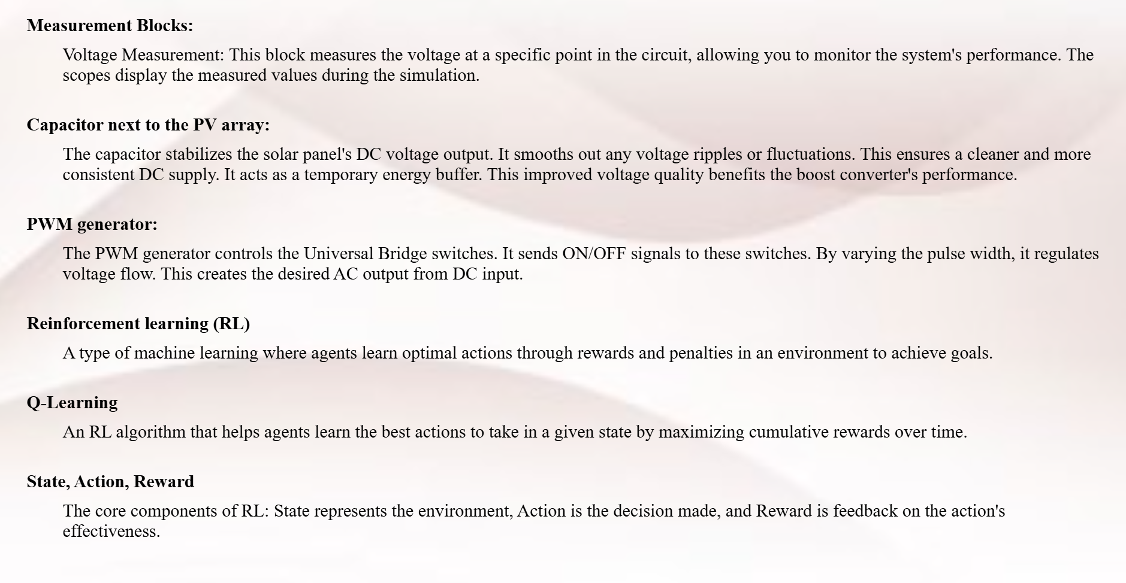
MAIN COMPONENTS

Slide 11
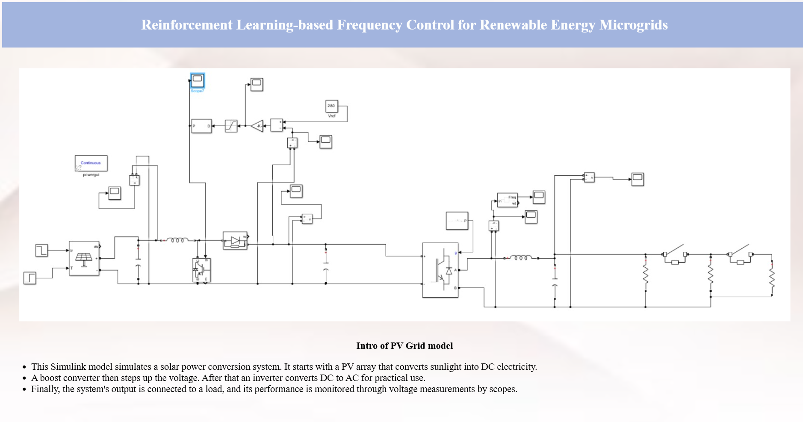
SIMULINK MODELS

Slide 12
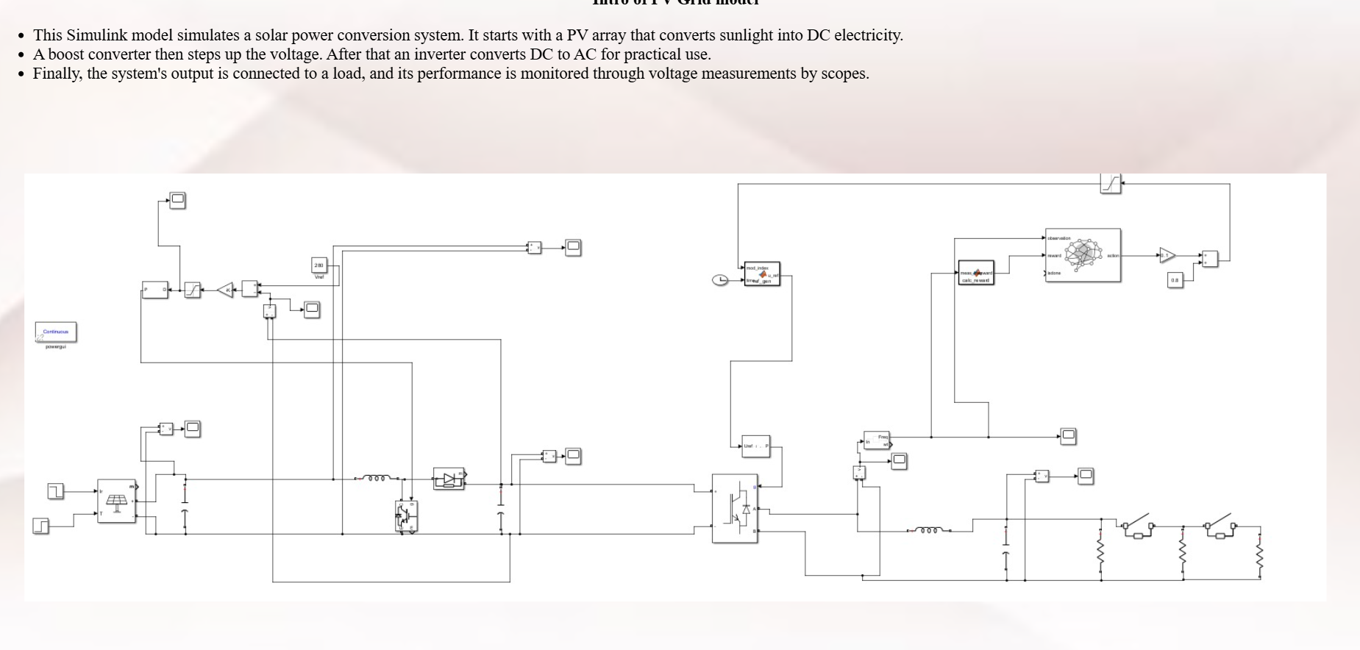
SIMULINK MODELS

Slide 13
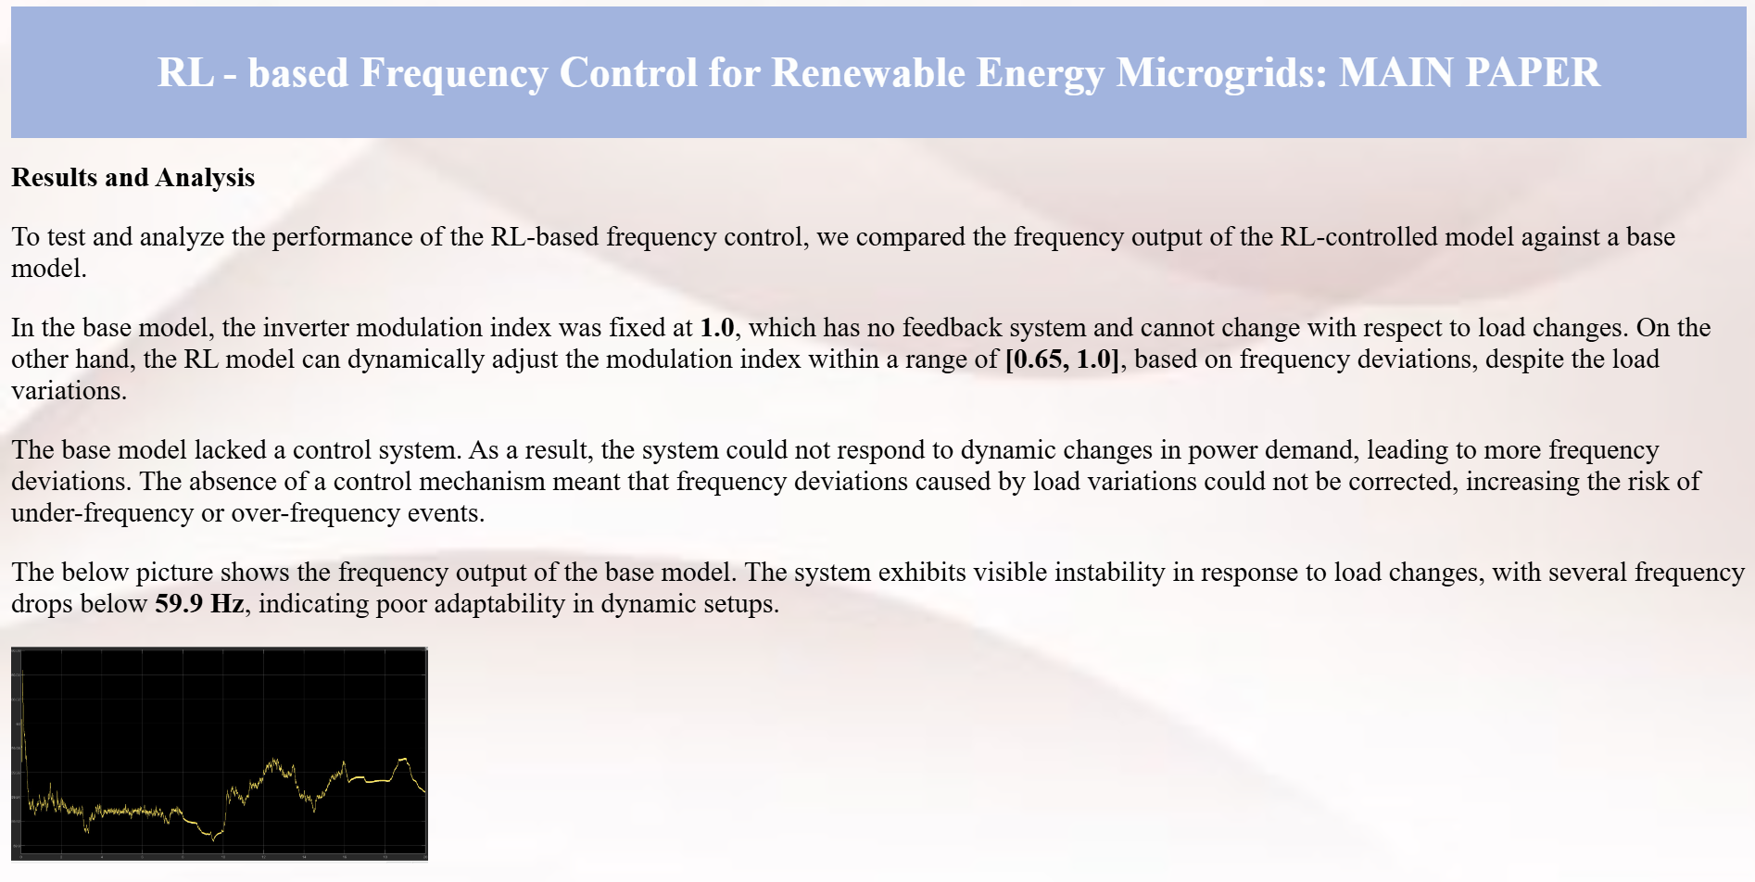
RESULTS AND ANALYSIS

Slide 14
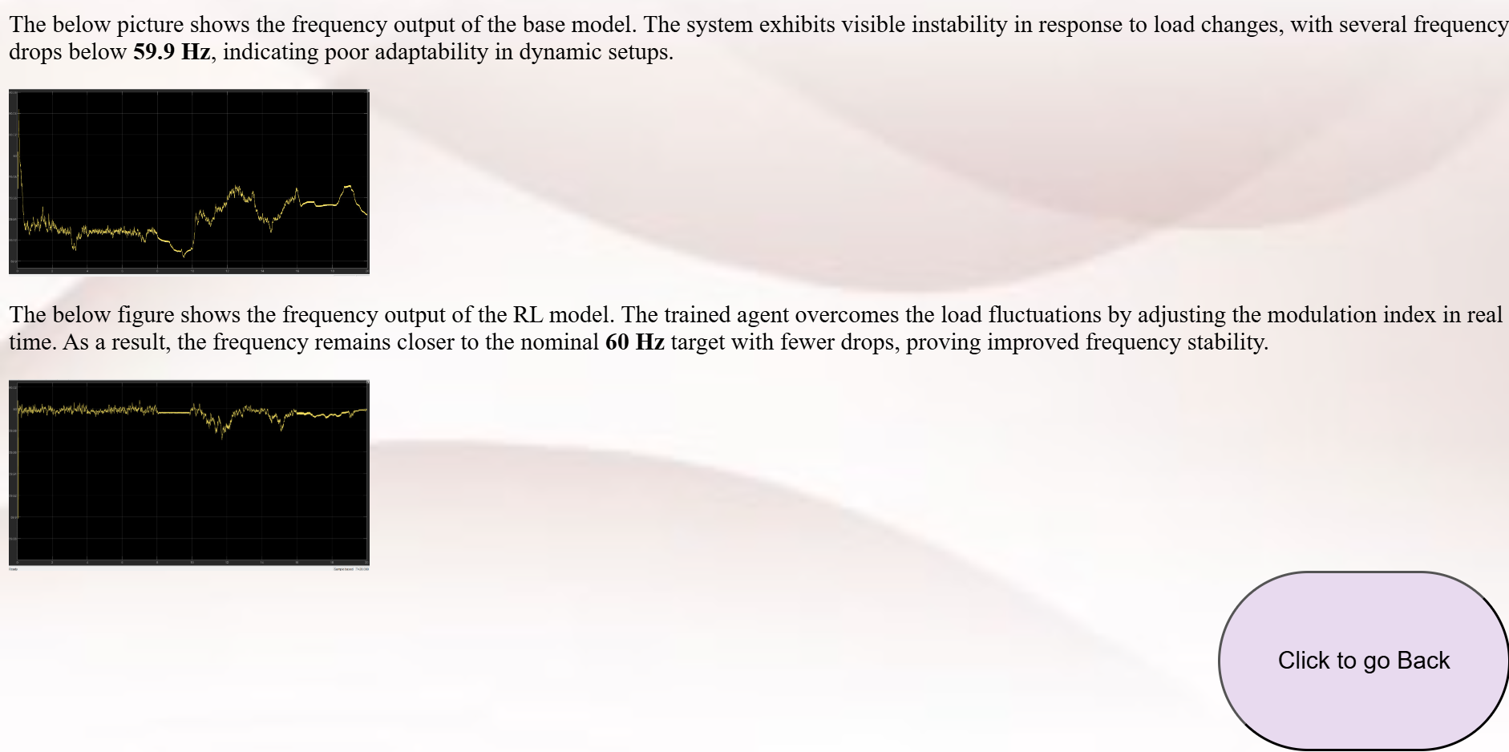
RESULTS AND ANALYSIS

Slide 15
Team Members
Kondakindi Supriya cb.sc.u4aie24025
Kopparappu Sasank Gupta cb.sc.u4aie24026
Korumilli Siva Kumar cb.sc.u4aie24027
Medasani Himabala cb.sc.u4aie24028
THANK YOU !
We are Group 7..

